Slide 1
Team No. 51
NyayVandan: AI-Driven Legal
Decision Support System
Presentation By,
Tanya Singh(23BTRCL087),
G Yaswanthi(23BTRCL187),
Snigdha Gooty(23BTRCL191)
Guided By,
Mr.Divyanshu Prakash Assistant Professor / AIML

Slide 2
CONTENTS
Abstract
Introduction
System requirement
Literature Survey
Existing system
Block diagram
Proposed System
Conclusion
Prototype
Frontend
Backend
References

Slide 3
ABSTRACT
NyayVandan is an AI-powered judicial decision support system designed to assist judges by retrieving legally relevant precedents with explainable reasoning and ethical safeguards.
Unlike existing legal AI tools that focus on prediction or keyword search, NyayVandan emphasizes case-based reasoning, transparency, and constitutional alignment.
The system integrates hybrid semantic–lexical retrieval, explainable AI techniques, and bias detection mechanisms to ensure responsible use.

Slide 4
By remaining strictly advisory and human-in-the-loop, NyayVandan enhances judicial efficiency while preserving judicial independence.

Slide 5
INTRODUCTION
Indian courts face severe backlog and delayed justice
Judges spend significant time on manual precedent research
Explosion of digitized judgments creates cognitive overload
AI can assist, but must be transparent, ethical, and non-directive

Slide 6
NyayVandan is proposed as a judge-centric decision support system, not an automated decision-maker

Slide 7
SYSTEM REQUIREMENT
Software CONFIGURATION
OS: Windows / Linux
Python 3.9+
Frameworks: Streamlit, FastAPI
Libraries: spaCy, Sentence-BERT, FAISS, Scikit-learn
Database: Local file system / vector index (offline)
Hardware CONFIGURATION
Processor: Intel i5 / Ryzen 5 or above
RAM: Minimum 8 GB (16 GB recommended)
GPU: Optional (for faster embedding inference)
Storage: 20+ GB for datasets and indexes

Slide 8
LITERATURE SURVEY
"AI-Driven Statutory Reasoning via Software Engineering Methods" by Rohan Padhye (2024)
Treats legal rules like computer programs for better understanding.
Makes AI more accurate in interpreting complex laws.
“AI in reasoning and attribute” by Michael De'Shazer (2024)
Uses AI to find biases in legal judgments.
Helps lawyers and judges make fairer decisions using AI-assisted arbitration.

Slide 9
"Human Centered AI for Indian Legal Text Analytics" by Sudipto Ghosh et al. (2024)
Builds AI tools specially designed for Indian law.
Helps lawyers understand legal documents faster with AI assistance.
"Justitia ex Machina: The Impact of an AI System on Legal Decision-Making" (2024)
Explores the development and use of an AI system for processing traffic violation appeals in a Dutch court.
It assesses the system's impact on legal decision-making and highlights considerations for AI integration in judicial processes.

Slide 10
Leading AI Legal Research by Varun Magesh et al. (2024)
Checks how accurate AI tools are in legal research.
Helps lawyers choose reliable AI tools and avoid misleading results.

Slide 11
EXISTING SYSTEM
Relies on keyword or citation-based search
No understanding of factual similarity
No explanation of why a case is relevant
No bias detection or constitutional checks
Designed mainly for lawyers, not judges

Slide 12
Limitations:
Time-consuming
Inconsistent outcomes
Risk of implicit bias
Lack of trust in AI outputs

Slide 13
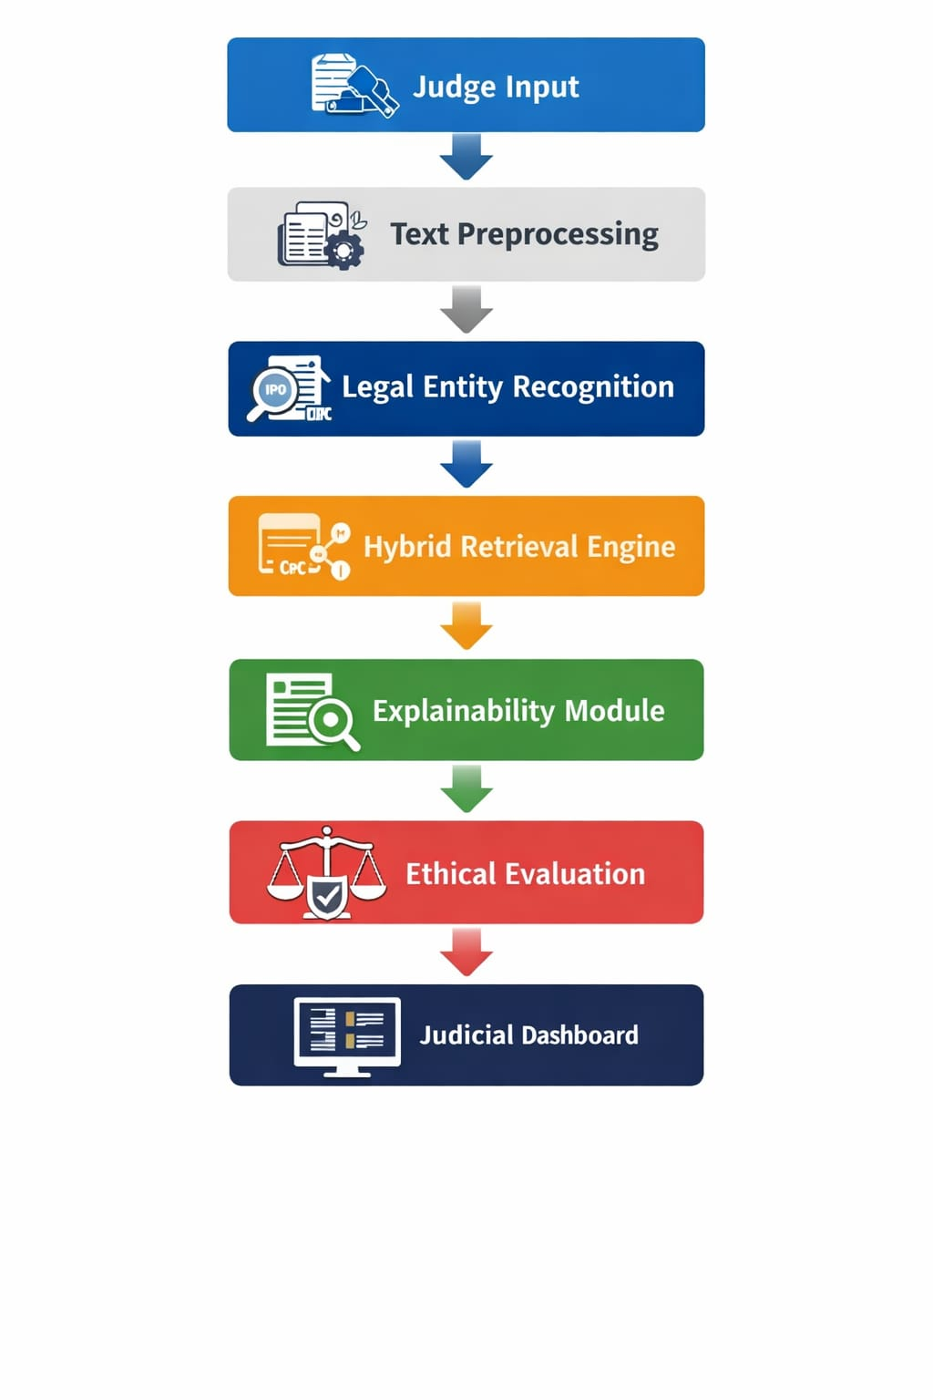
Execution Flow

Slide 14
Proposed System
Hybrid semantic + lexical + entity-based retrieval
Uses Sentence-BERT embeddings and TF-IDF/BM25
Provides citeable explanations using XAI methods
Computes diversity score to flag biased precedent sets
Checks alignment with constitutional principles
Fully human-in-the-loop and advisory

Slide 15
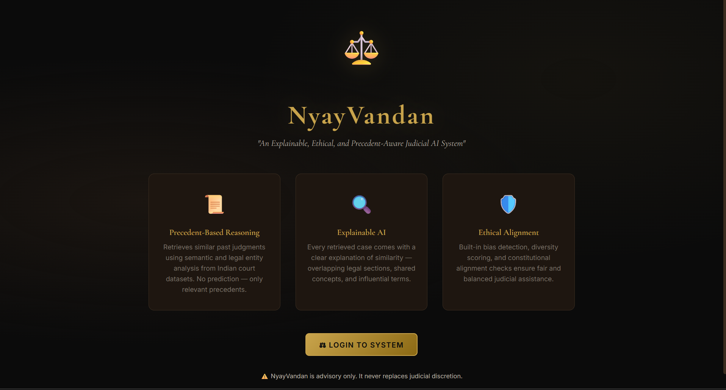
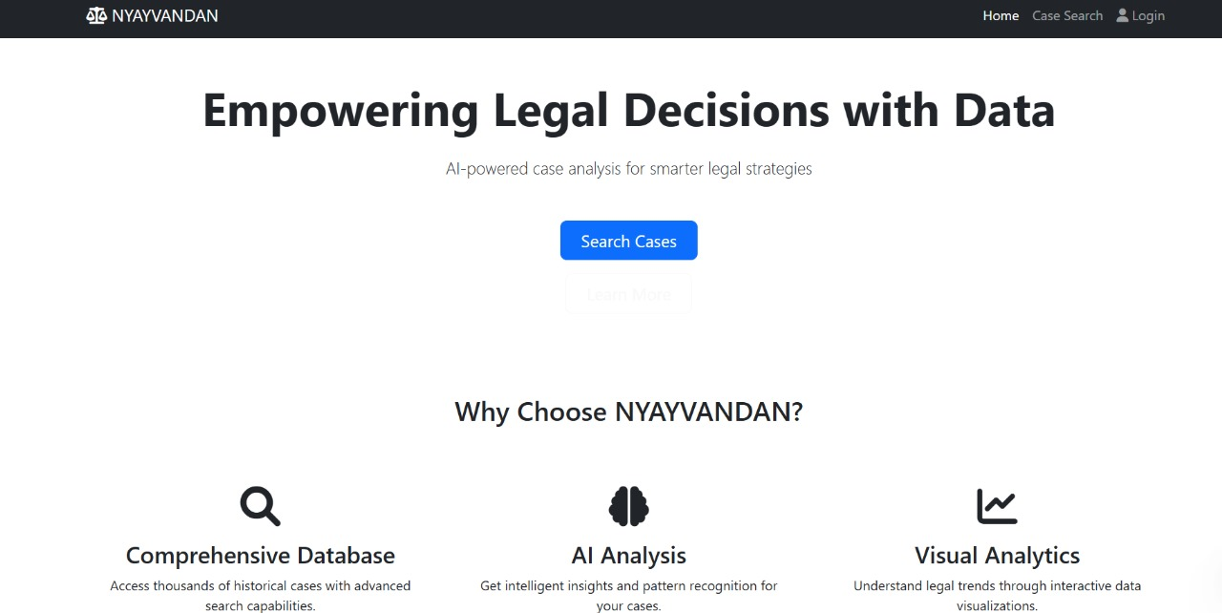
Prototype
Frontend:

Slide 16
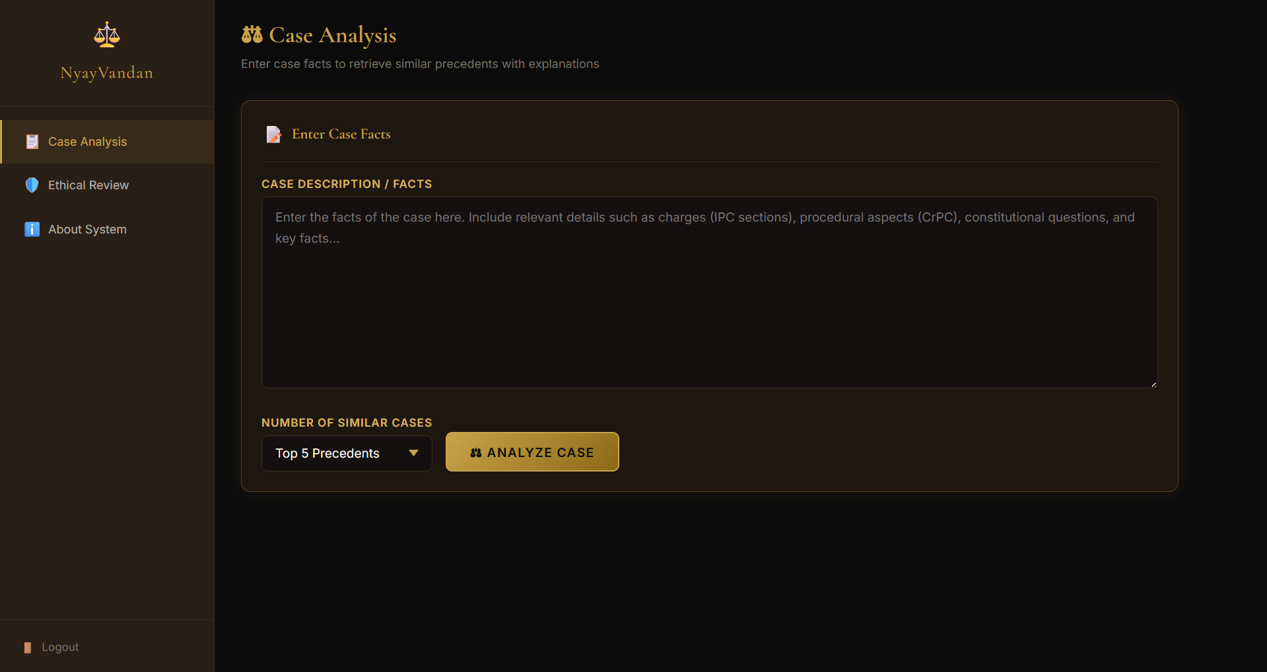
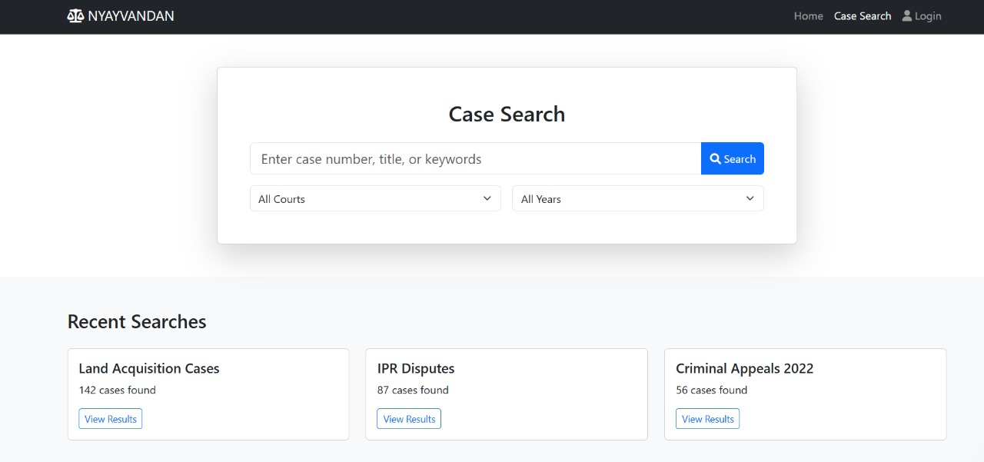

Slide 17
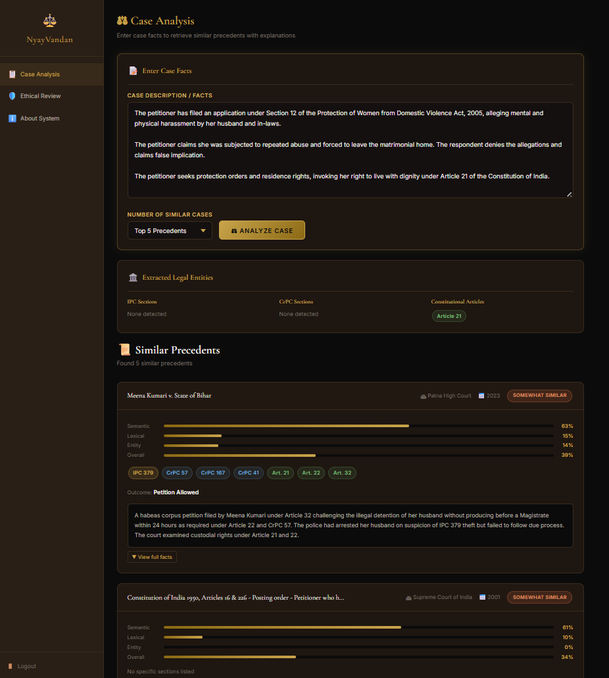
.
Backend:

Slide 18
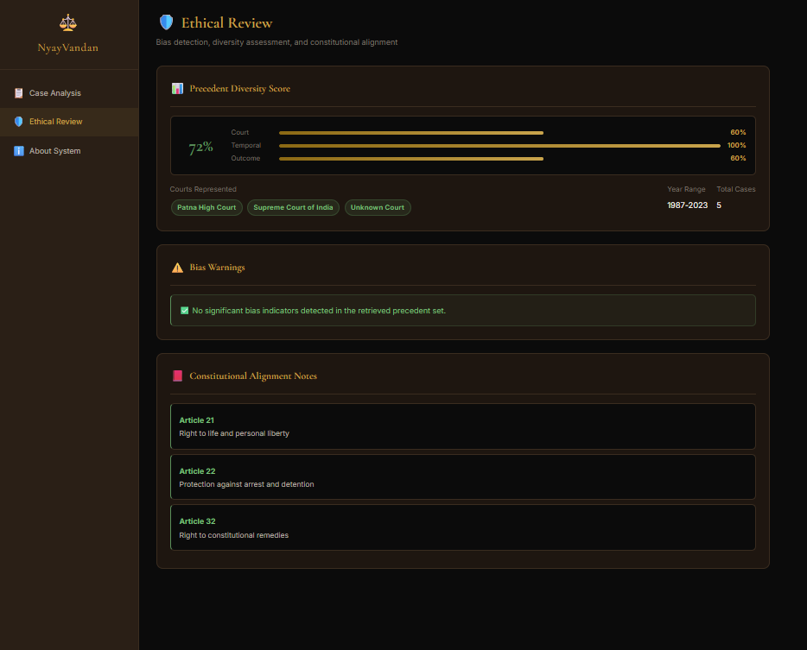
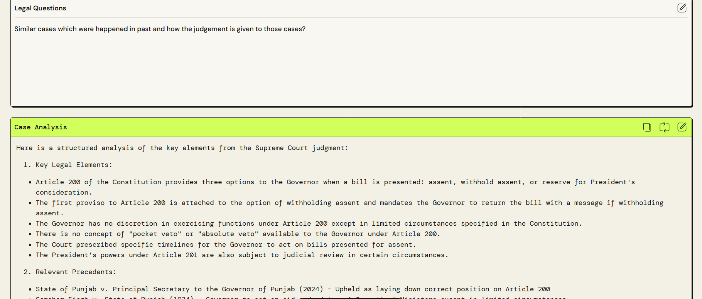

Slide 19
CONCLUSION:
NyayVandan demonstrates how AI can responsibly assist the judiciary by shifting focus from prediction to reasoning. By integrating explainability, ethics, and precedent-aware retrieval within an India-specific legal framework, the system enhances efficiency while safeguarding judicial autonomy. NyayVandan offers a practical, ethical, and scalable path for AI adoption in courts.

Slide 20
Reference Links:
[2402.04140] Advancing Legal Reasoning: The Integration of AI to Navigate Complexities and Biases in Global Jurisprudence with Semi-Automated Arbitration Processes (SAAPs)
[2405.20362] Hallucination-Free? Assessing the Reliability of Leading AI Legal Research Tools
[2404.09868] Software Engineering Methods For AI-Driven Deductive Legal Reasoning
[2403.10944] Human Centered AI for Indian Legal Text Analytics
Justitia ex machina: The impact of an AI system on legal decision-making and discretionary authority - Daan Kolkman, Floris Bex, Nitin Narayan, Manuella van der Put, 2024

Slide 21
THANK YOU

